Slide 1
Big Data Systems
Pravin Y Pawar

Slide 2
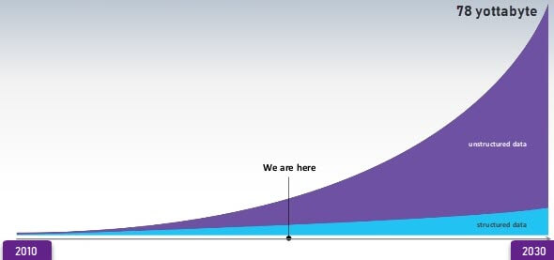
Data Growth
Data Generation
Source : https://www.guru99.com/what-is-big-data.html

Slide 3



Big Data Systems
What?
New Paradigm for Data Analytics
Information
Data
Insight

Slide 4

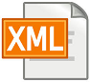


Data Classification
Types of Data
Databases
XML
Web pages
Images
Structured
Semi-structured
Unstructured

Slide 5
Data Usage Pattern
Usage Stats

Slide 6
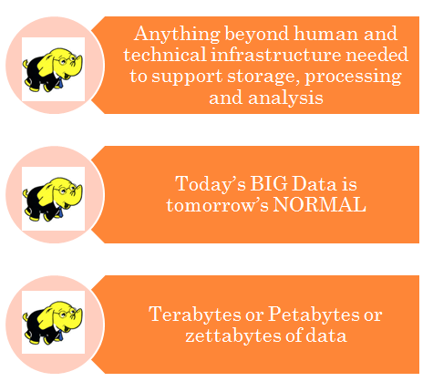
Big Data
Defined

Slide 7
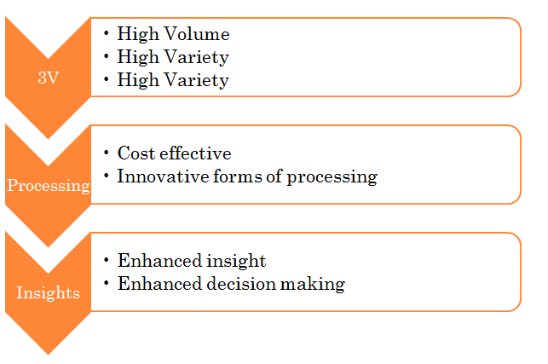
Big data – by Gartner

Slide 8
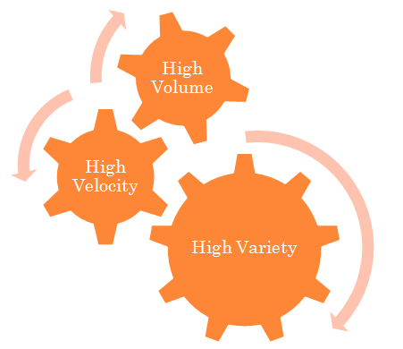
3 V’s of Big Data
Volume, Velocity and Variety

Slide 9

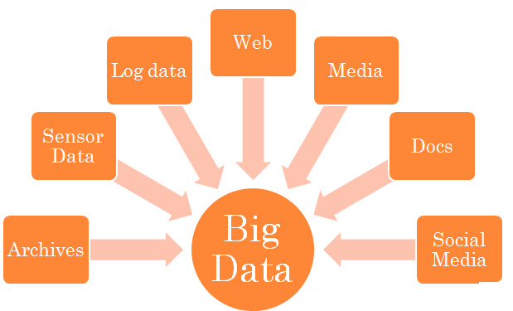
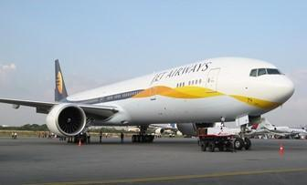

Sources of Big Data
New Age Data Sources
Source : https://www.guru99.com/what-is-big-data.html

Slide 10
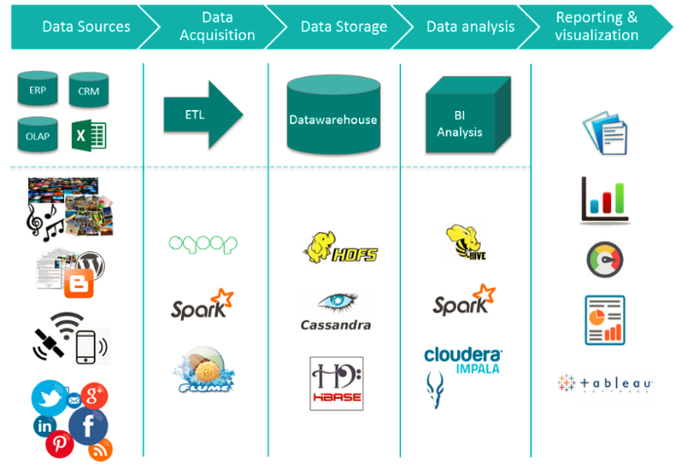
Big Data Ecosystem
Landscape of Big Data Systems
Source : https://medium.com/@jain6968/big-data-ecosystem-b0e4c923d7aa

Slide 11
Thank You!
In our next session: Desired Properties of Big Data Systems

